Slide 1



Job Salary Prediction
DataRObot
Arjoo Gangwal
Dhanashree Mane
Sanya Purwar

Slide 2

What are we doing?
Salary is a big deciding factor for a majority of people
We are trying to build a model that would predict the average salary based on
Job title
Location
Years of experience
Company Size
Company Sector
Currently most of the Job postings online doesn’t mention the average salary offered for a position.

Slide 3
Project PIPELINE
Collecting the data
We scraped data from Indeed
Used Beautifulsoup to scrape.
Data Cleaning
The Job title, Location and Salaries were mapped to the company size and Sector.
We removed Outliers and dealt with incomplete rows.
Data Correlation
We used Multiple Linear Regression to fit our model.
Features incorporated: Location, Years of experience, Company size and Sector.

Slide 4
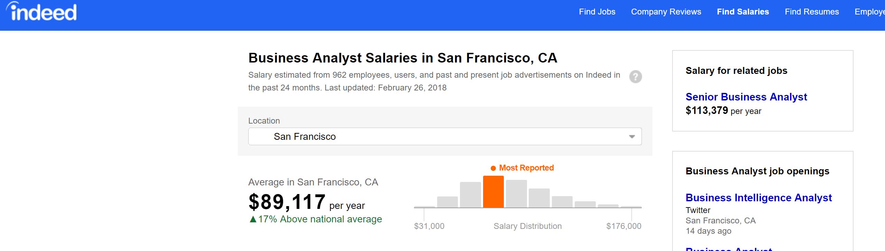
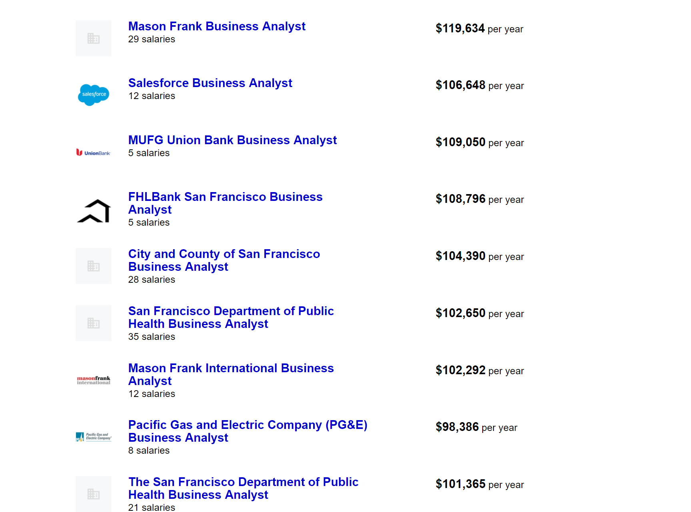
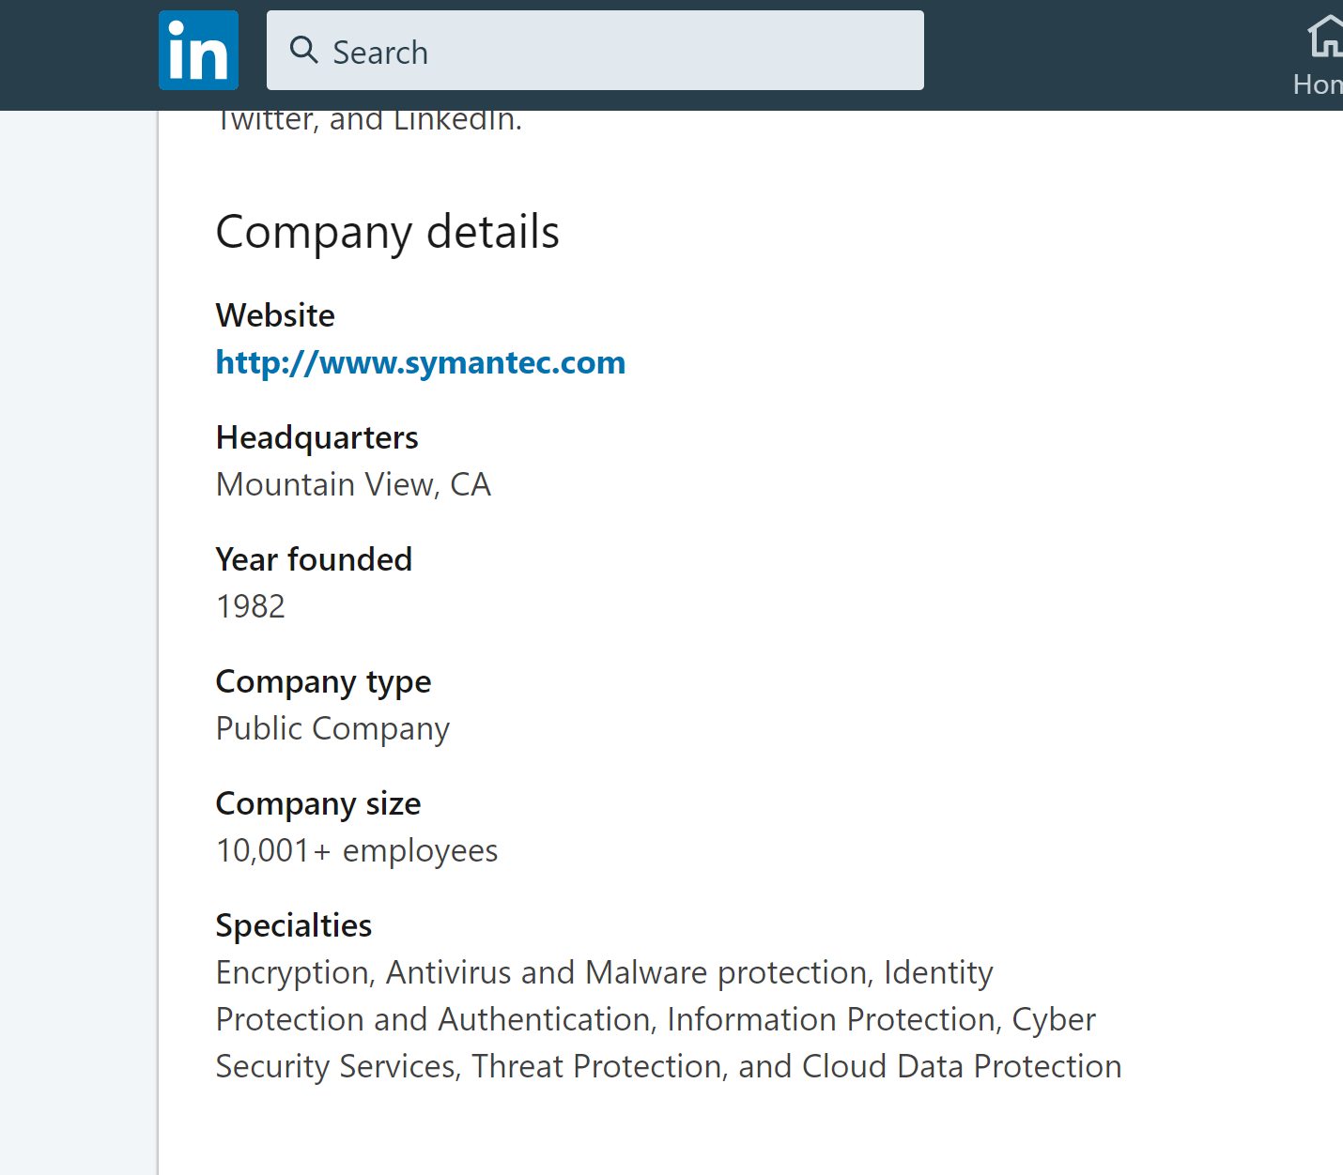
Company Name, Average Salary, Job Location from Indeed
Company Profile from LinkedIn, Glassdoor

Slide 5
Challenges We Faced
Had to manually map the company name with their respective company size and sector by taking information about each company name from Linkedin
1
Had to manually match the salary with the Years of experience taking references from Glassdoor.com
2

Slide 6
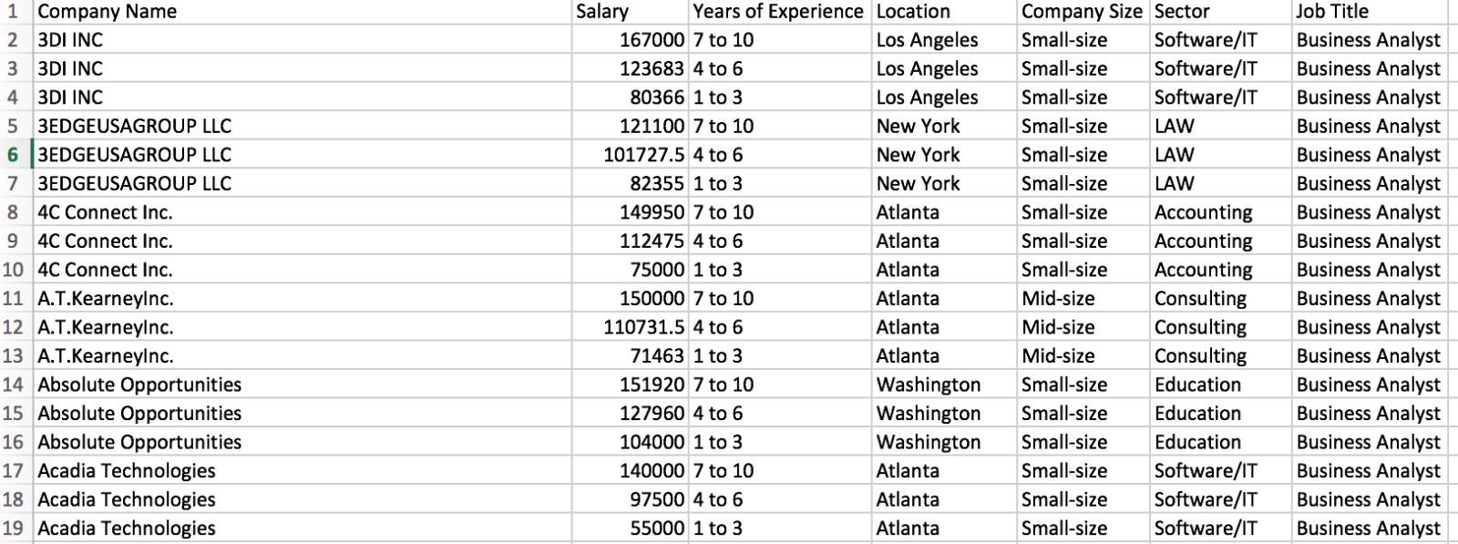
Our Data LOOKS like

Slide 7




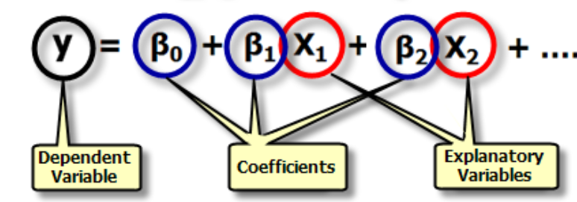
Why Multiple linear regression?
Independent Variables(X1,X2,..Xn): Location, Yrs. of Experience, Company Size, Sector.
Dependent Variable(y): Salary
Location
Years of Experience
Company Size
Company Sector

Slide 8
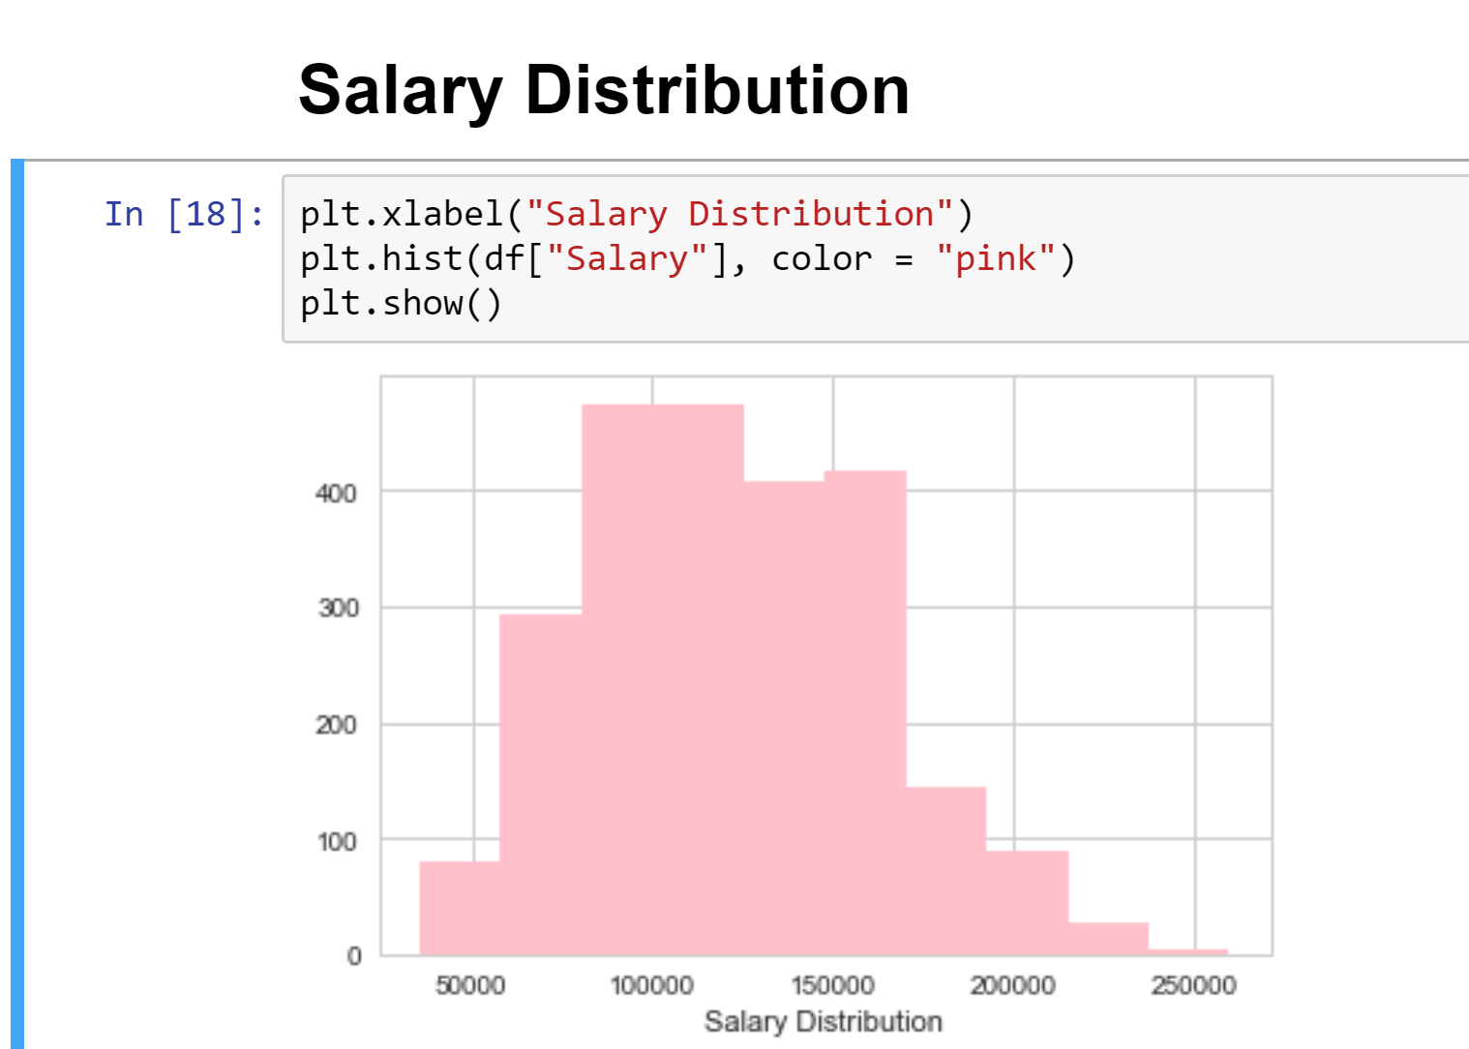
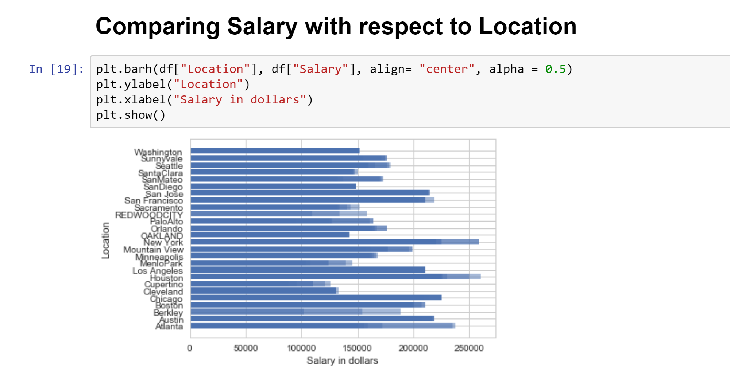

Slide 9
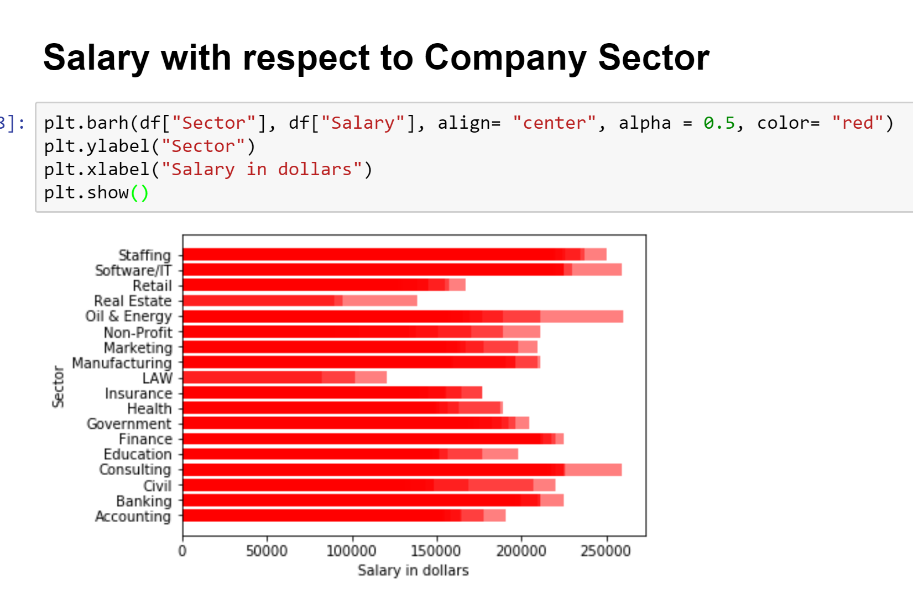
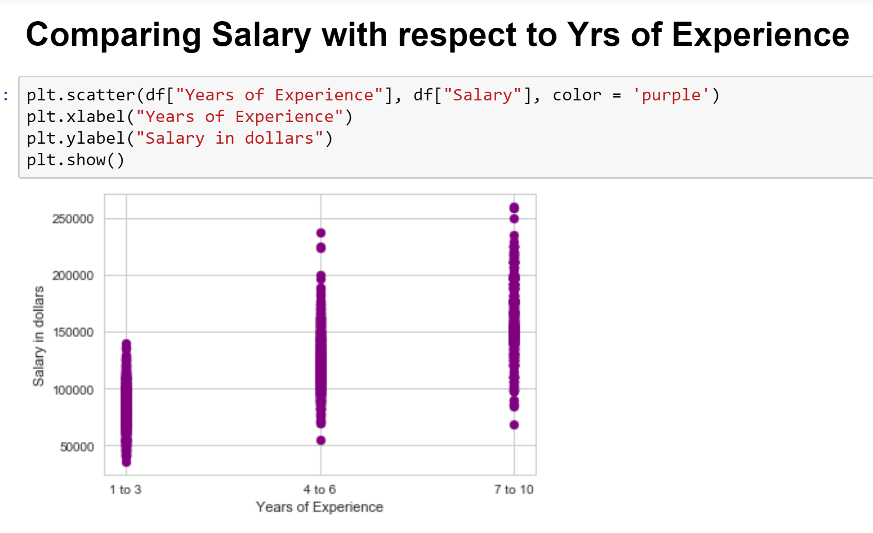

Slide 10
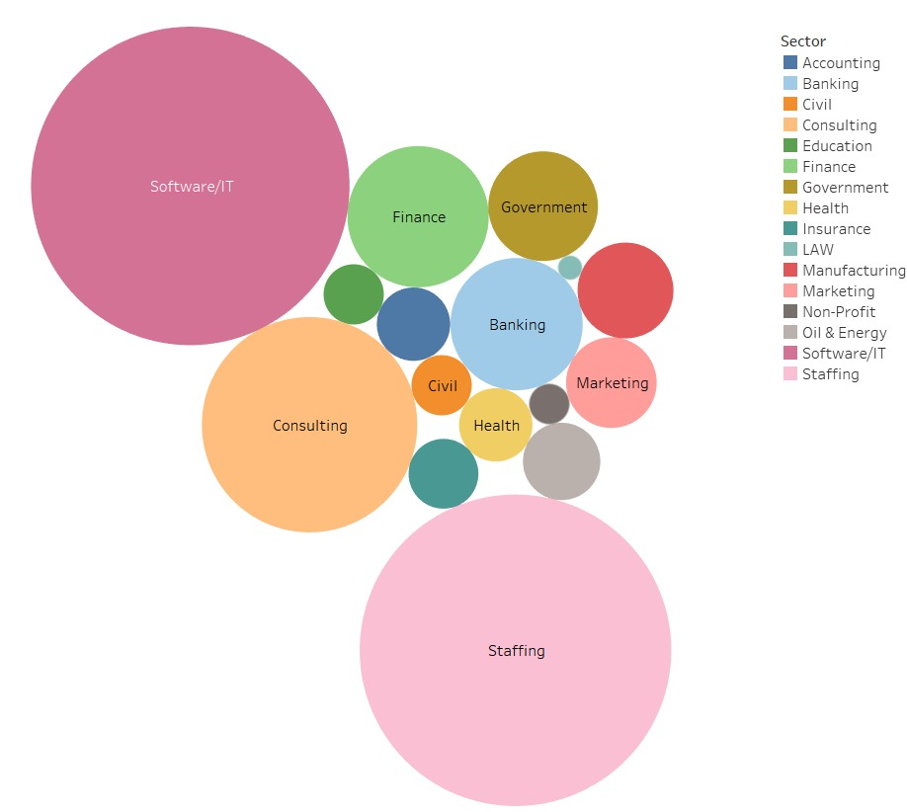
Salary with respect to Company sector

Slide 11
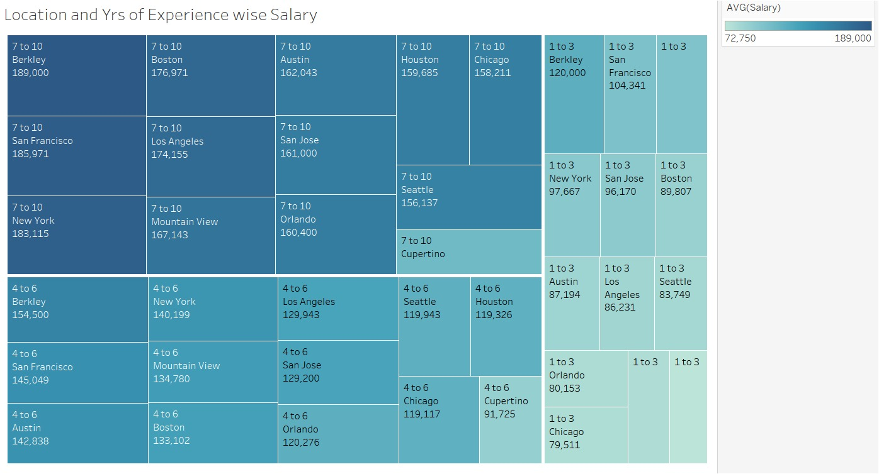

Slide 12
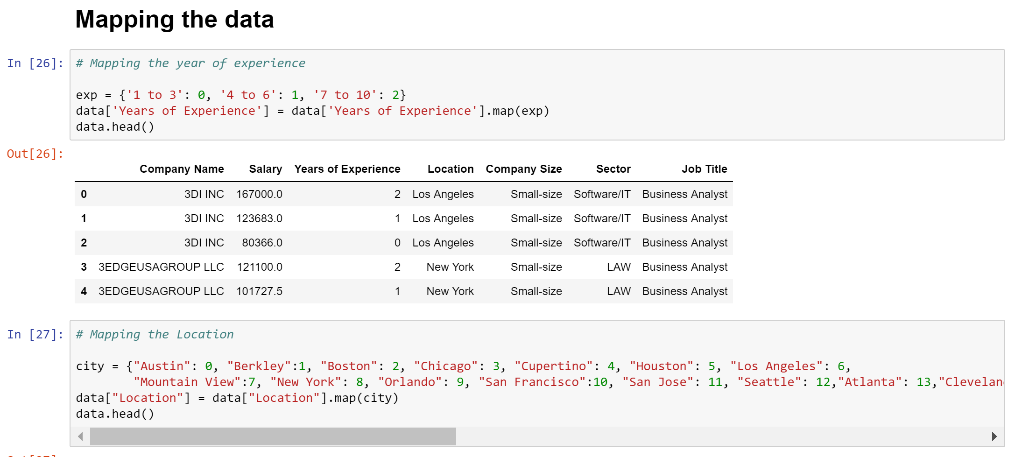

Slide 13
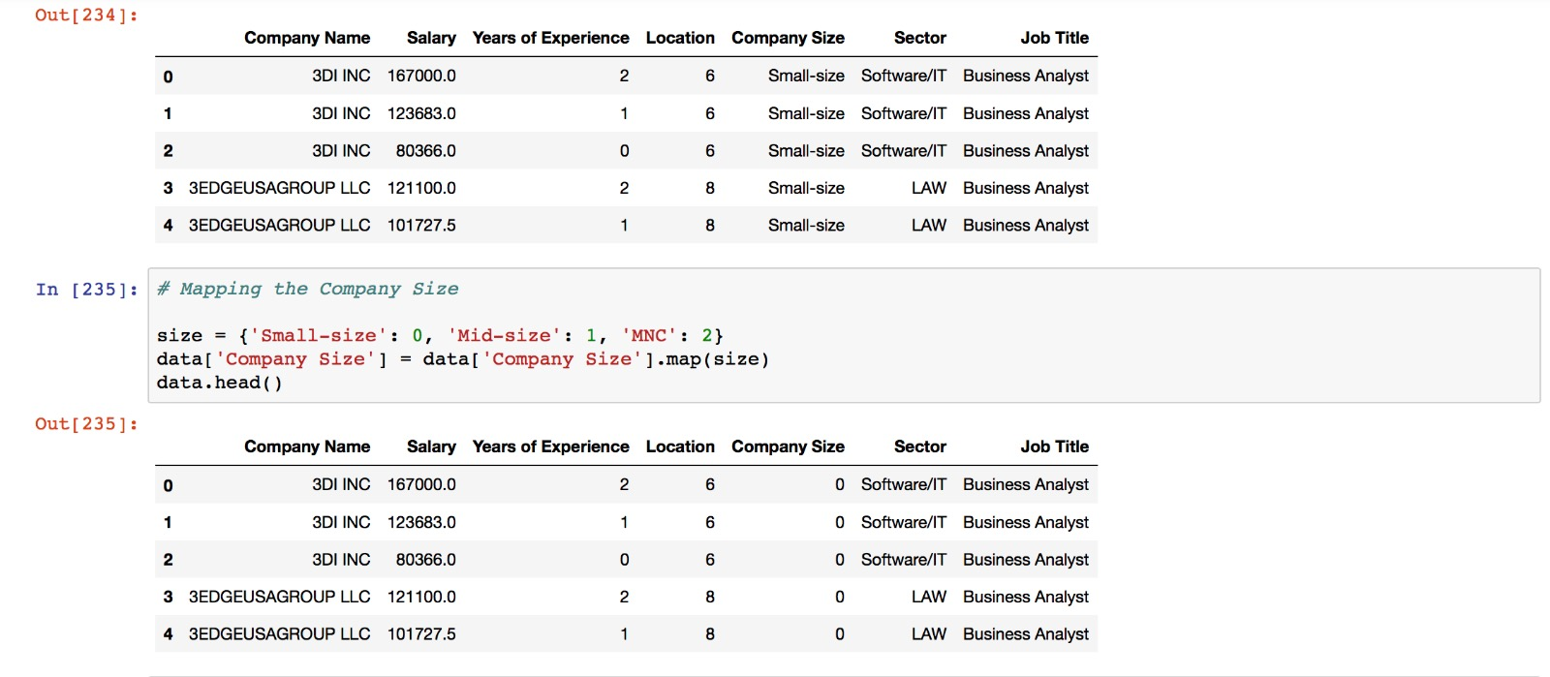

Slide 14
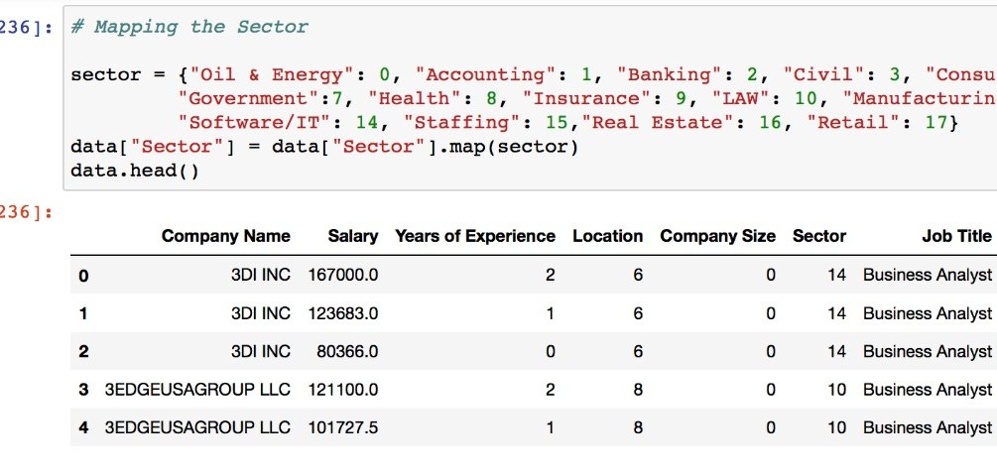

Slide 15
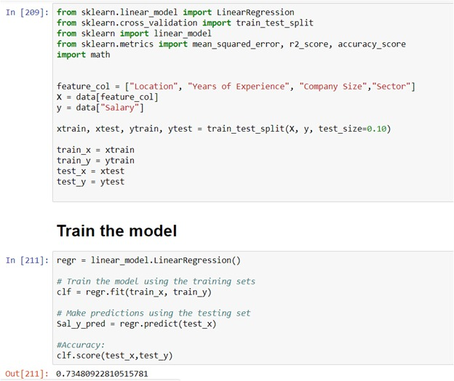
Prediction and Accuracy
Accuracy- 73.48%

Slide 16
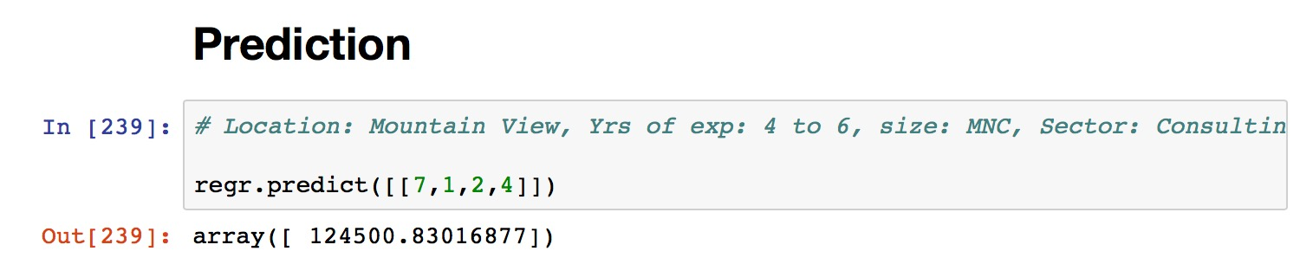
Predicting Salary

Slide 17
Future enhancements
Currently we have data for Business Analyst only, We will be adding more Job titles like Project Manager, Software Engineer, Operations Manager, Data Scientist.
Currently we have collected the salaries in 26 cities, we will be adding data for more cities.

Slide 18

Thank you!

